Slide 1
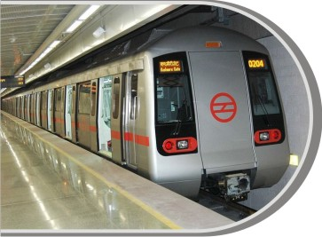
DELHI METRO TRAINS {A BOON FOR ALL}
Delhi’s Pride A Metro Ride
Advertise inside the Swank Passenger Cabins
through Inside Panels & Handle Bars

Slide 2
Delhi’s Pride – A Metro Ride
Advertise inside the Swank Passenger Cabins
ALL IN ONE
 TIME SAVING
 AC COMFORT
 SAFE
 MODERN AND TRENDY
 USER FRIENDLY
 ECONOMICAL
Back to Index

Slide 3
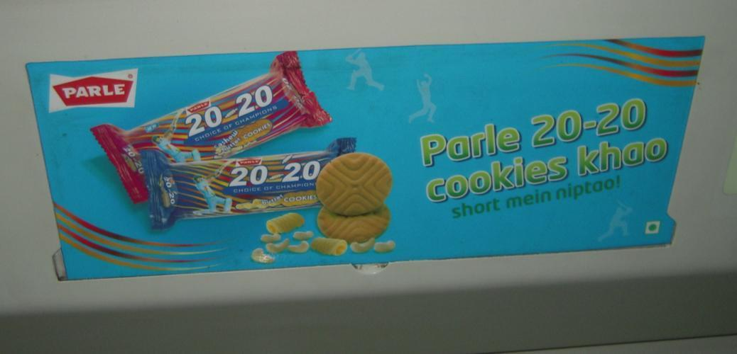
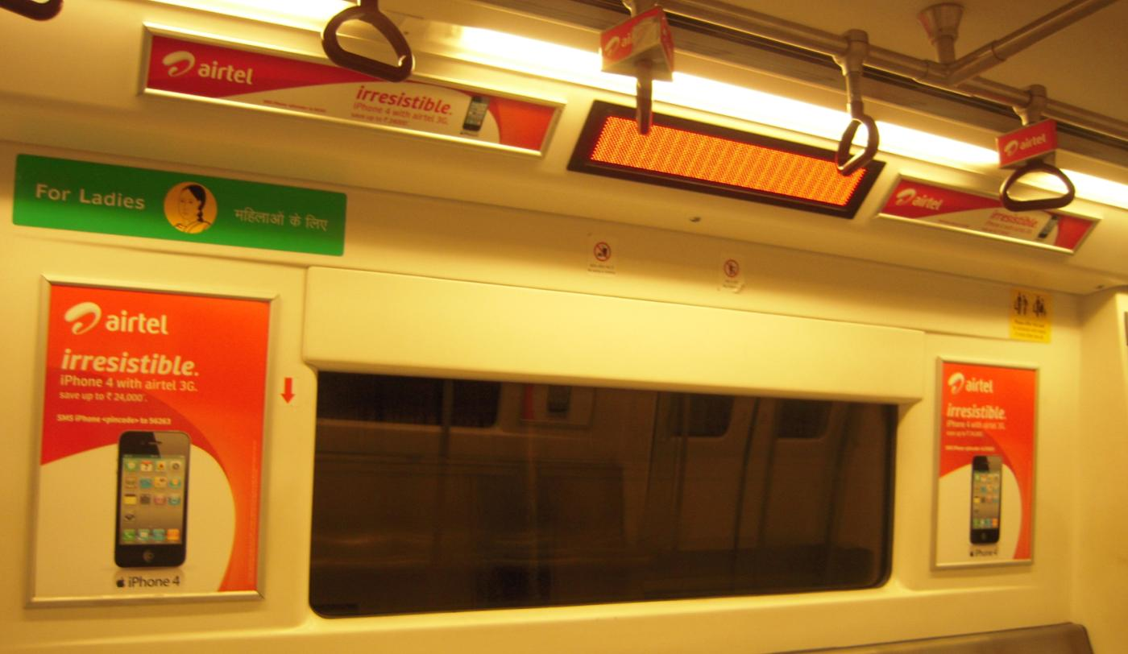
WHY TO ADVERTISE IN METRO ?
 One of the few Legal Media’s in Delhi
 Reaches consumers on the move
 Captured audience
 Prominent size - easily noticeable
 Clutter free
 Impact full environment
 Mass appeal - convenient medium for all
 Very economical
 In underground - no outside view
 Higher frequency - higher retention
 Excellent support medium (reinforcing)

Slide 4
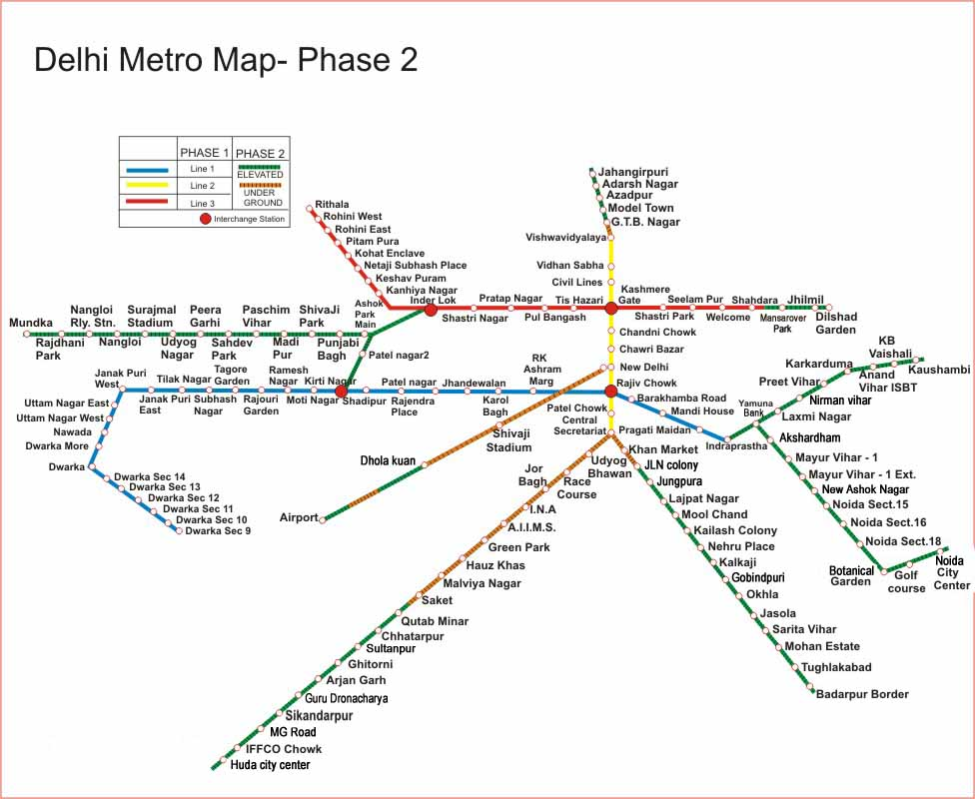
Dwarka Sec 8
Dwarka Sec 21

Slide 5
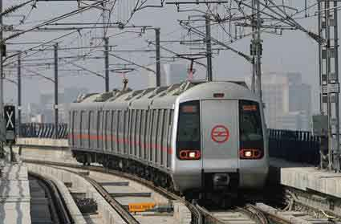
LINE – 1 (Red Line)
1. Dilshad Garden
2. Jhilmil
3. Mansarovar Park
4. Shahdara
5. Welcome
6. Seelampur
7. Shastri Park
8. Kashmere Gate
9. Tis Hazari
10. Pul Bangash
11. Pratap Nagar
12. Shastri Nagar
13. Inder Lok
14. Kanhiya Nagar
15. Keshav Puram
16. Netaji Subhash Place
17. Kohat Enclave
18. Pitam Pura
19. Rohini East
20. Rohini West
21. Rithala
DILSHAD GARDEN TO RITHALA
Covers East , Central, North & North West Delhi with
Rotem Trains (4 Boggies)
running across 21 stations

Slide 6
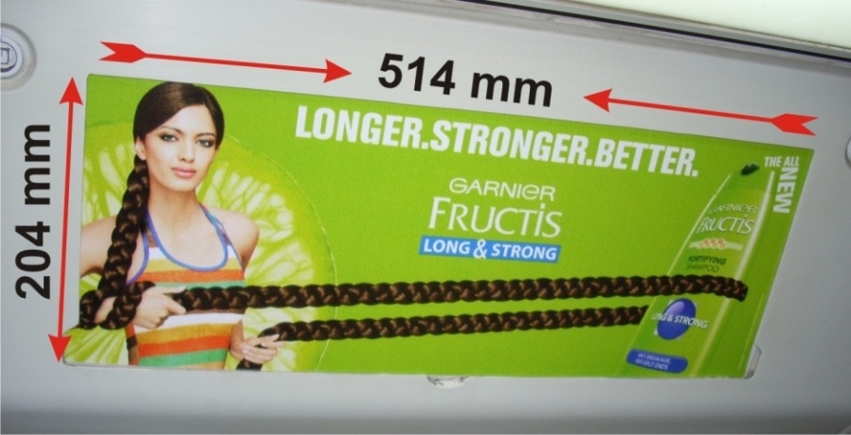
PANELS OPPORTUNITY IN ROTEM TRAINS ON
LINE 1 ( Dilshad Garden To Rithala)
AD Panels on inside walls of Metro Boggies
NO. OF PANELS in 4 Boggies Train:
54 panels in each train with 4 Boggies
2 Boggies with 13 Panels each (First & Last boggie)
2 Boggies with 14 Panels each (Middle boggie)
PANELS DETAIL INSIDE ROTEM DELHI METRO TRAINS
Size of Panel | No of Trains | No. of Boggies Per Train | Total Boggies | Total Panels
514mm x 204mm | 29 | 4 | 116 | 1566
Taxes extra as applicable

Slide 7
LINE – 3 & 4 (Blue Line)
(DWARKA TO NOIDA CITY CENTRE/ VAISHALI)
1. Dwarka Sec-21
2. Dwarka Sec-08
3. Dwarka Sec-09
4. Dwarka Sec-10
5. Dwarka Sec-11
6. Dwarka Sec-12
7. Dwarka Sec-13
8. Dwarka Sec-14
9. Dwarka
10. Dwarka More
11. Nawada
12. Uttam Nagar West
13. Uttam Nagar East
14. Janakpuri West
15. Janakpuri East
16. Tilak Nagar
17. Subhash Nagar
18. Tagore Garden
19. Rajouri Garden
20. Ramesh Nagar
21. Moti Nagar
22. Kirti Nagar
23. Shadipur
24. Patel Nagar
25. Rajendra Place
26. Karol Bagh
27. Jhandewalan
28. R.K. Ashram Marg
29. Rajiv Chowk
30. Barakhamba Road
31. Mandi House
32. Pragati Maidan
33. Indraprastha
34. Yamuna Bank
TO NOIDA CITY CENTRE
1. Akshardam Temple
2. Mayur Vihar – I
3. Mayur Vihar Ext.
4. New Ashok Nagar
5. Noida Sec-15
6. Noida Sec-16
7. Noida Sec-18
8. Botanical Garden
9. Golf Course
10. Noida City Centre (Sec 32)
Covers West, Central, Heart
of the City (C.P), East Delhi
& Noida with
27 Rotem Trains (4 Boggies)
4 Rotem Trains (6 Boggies)
33 Bombardier Trains (6 Boggies) running across 51 stations
TO VAISHALI
1. Laxmi Nagar
2. Nirman Vihar
3. Preet Vihar
4. Karkarduma
5. Anand Vihar ISBT
6. Kaushambi
7. Vaishali

Slide 8
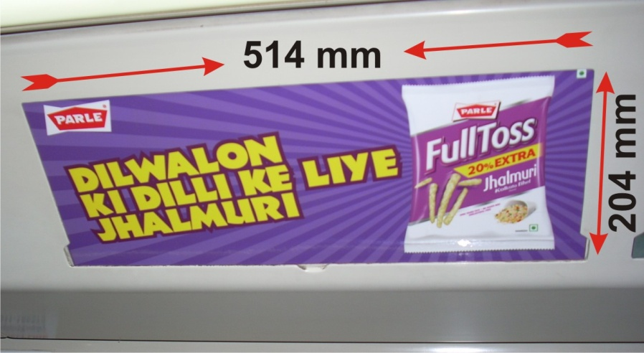
PANELS OPPORTUNITY IN ROTEM TRAINS ON
LINE 3 & 4 ( Dwarka To Noida City Centre/ Vaishali)
AD Panels on inside walls of Metro Boggies
NO. OF PANELS:
54 panels in each train with 4 boggies
2 boggies with 13 Panels each (First & Last boggie)
2 boggies with 14 Panels each (Middle boggies)
82 panels in each train with 6 boggies
2 boggies with 13 Panels each (First & Last boggie)
4 boggies with 14 Panels each (Middle boggies)
SIZE: 514mm(width) x 204mm(height)
(Not back-lit but sufficiently bright interiors)
PANELS DETAIL INSIDE ROTEM DELHI METRO TRAINS
Size of Panel | No of Trains | No. of Boggies Per Train | Total Boggies | Total Panels
514mm x 204mm | 27 | 4 | 108 | 1458
514mm x 204mm | 4 | 6 | 24 | 328
Total | 31 |  | 132 | 1786

Slide 9
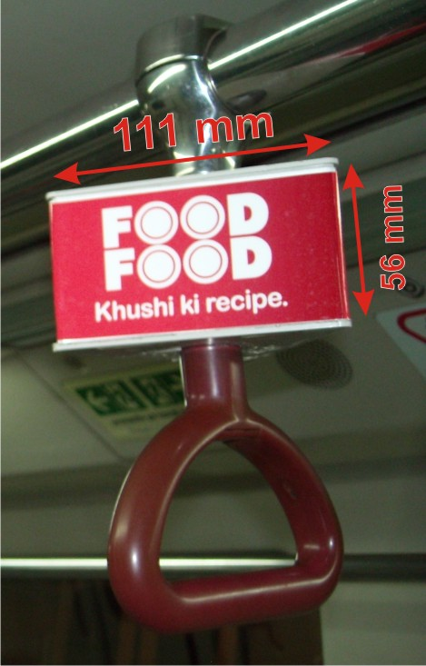
HANDLE BAR OPPORTUNITY IN ROTEM TRAINS ON
LINE 3 & 4 ( Dwarka To Noida City Centre/ Vaishali)
Triangle Shaped Box fixed with the Handle Bar inside Metro Trains
SIZE: 111mm(width) x 56mm(height) x 3 Sides
Detail of HANDLE BAR in 4 Boggies Train:
Total Handle Bar to be used for branding:
86 Handle Bars (Every Alternative Handle Bars)
2 Boggies with 21 Handle Bars each (First & Last boggie)
2 Boggies with 22 Handle Bars each (Middle boggies)
Detail of HANDLE BAR in 6 Boggies Train:
Total Handle Bar to be used for branding:
130 Handle Bars (Every Alternative Handle Bars)
2 Boggies with 21 Handle Bars each (First & Last boggie)
4 Boggies with 22 Handle Bars each (Middle boggies)
HANDLE BARS DETAIL INSIDE ROTEM DELHI METRO TRAINS
Size | No of Trains | No. of Boggies Per Train | Total Boggies | No. of Handle Bar Per Boggie
111mm x 56mm x 3 Sides | 27 | 4 | 108 | 21/22
111mm x 56mm x 3 Sides | 4 | 6 | 24 | 21/22
 | 31 |  | 132

Slide 10
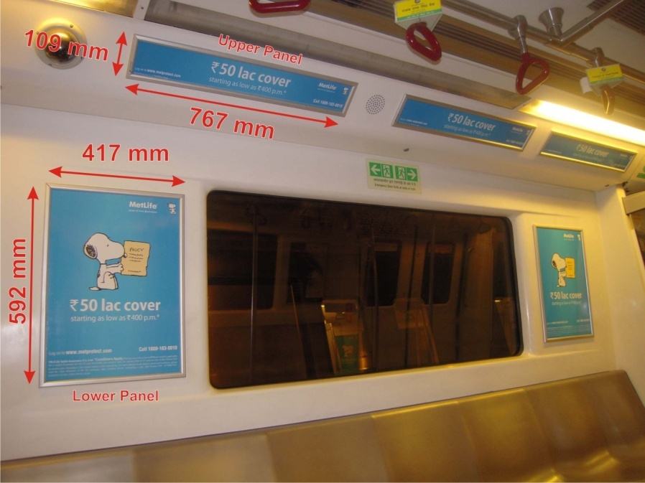
PANELS OPPORTUNITY IN BOMBARDIER TRAINS ON
LINE – 3 & 4 ( Dwarka To Noida City Centre/ Vaishali)
AD Panels on inside walls of Metro boggies
NO. OF UPPER PANEL in a Train
98 panels in each train with 6 boggies
SIZE: 767mm(width) x 109mm(height
NO. OF LOWER PANEL in each Train
74 panels in each train with 6 boggies
SIZE: 417 mm (width) x 592 mm (height)
(Not back-lit but sufficiently bright interiors)
Division of Panels in SETS* :
36 Sets* + 2 Single Lower + 8 Single Upper Panels
in each train with 6 boggies
* (1 Set contains:- 2 Lower Panels + 2 or 3 Upper Panels)
SETS* OF PANELS DETAIL INSIDE BOMBARDIER DELHI METRO TRAINS
Size (W x H) | No of Trains | No. of Boggies Per Train | Total Boggies | No. of Set* Per Boggie |  | Total Set* of Panels
 |  |  |  | I & Last Each | Middle Each
767mm x 109mm Upper Panel | 33 | 6 | 198 | 6 Sets* + 1 Single Lower Panel | 6 Sets* + 2 Single Upper Panel | 1221
417mm x 592mm Lower Panel
*One Set Contains : 2 Lower Panels + 2/3 Upper Panels
Back to Index

Slide 11
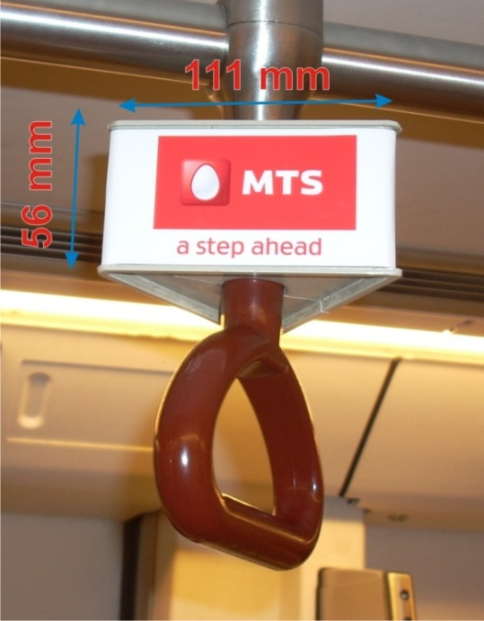
HANDLE BAR OPPORTUNITY IN BOMBARDIER TRAINS ON
LINE – 3 & 4 ( Dwarka To Noida City Centre/ Vaishali)
Triangle Shaped Box fixed with the Handle Bar inside Metro Trains
SIZE: 111mm(width) x 56mm(height) x 3 Sides
Detail of HANDLE BAR in 6 Boggies Train:
Total Handle Bar to be used for branding:
212 Handle Bars (Every Alternative Handle Bars)
2 Boggies with 34 Handle Bars each (First & Last boggie)
4 Boggies with 36 Handle Bars each (Middle boggies)
HANDLE BARS DETAIL INSIDE BOMBARDIER DELHI METRO TRAINS
Size | No of Trains | No. of Boggies Per Train | Total Boggies | No. of Handle Bar Per Boggie
111mm x 56mm x 3 Sides | 33 | 6 | 198 | 34/36

Slide 12
PANELS & HANDLE BAR DETAIL INSIDE DELHI METRO TRAINS
Metro Line | Metro Route | Train Type | No. of Train | No. of Boggies Per Train | Total Boggies | Media | Size of Media | Media in a Train
1 | Dilshad Garden - Rithala | Rotem Train | 29 | 4 | 116 | Panels | 514mm x 204mm | 54
3 & 4 | Dwarka - Noida City Centre/ Vaishali | Rotem Trains | 27 | 4 | 108 | Panels | 514mm x 204mm | 54
 |  |  |  |  |  | Handle Bars | 111mm x 56mm x 3 Sides | 86
 |  |  | 4 | 6 | 24 | Panels | 514mm x 204mm | 82
 |  |  |  |  |  | Handle Bars | 111mm x 56mm x 3 Sides | 130
 |  | Bombardier Trains | 33 | 6 | 198 | Lower Panels | 417mm x 592mm | 37 Set*
 |  |  |  |  |  | Upper Panels | 767mm x 109mm
 |  |  |  |  |  | Handle Bars | 111mm x 56mm x 3 Sides | 212
 |  |  | 93 |  | 446

Slide 13
PANELS LAYOUT INSIDE BOMBARIDER TRAIN’S BOGGIES
(Layouts of First & Last Boggies)
(Layout of Middle Boggies)

Slide 14
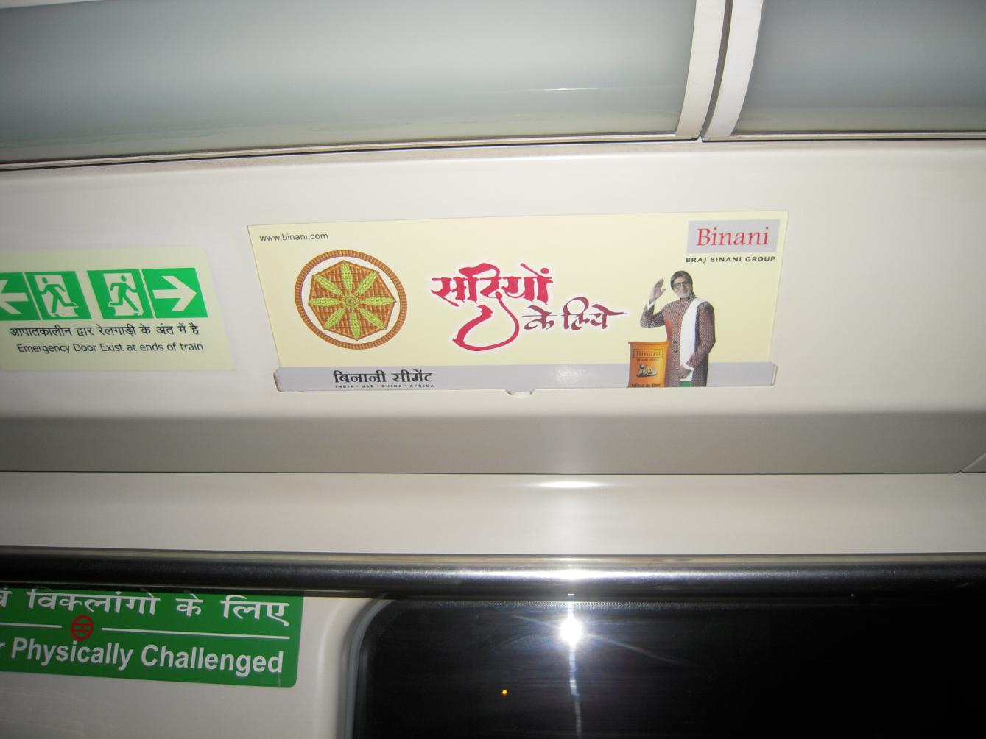
Back to Index

Slide 15
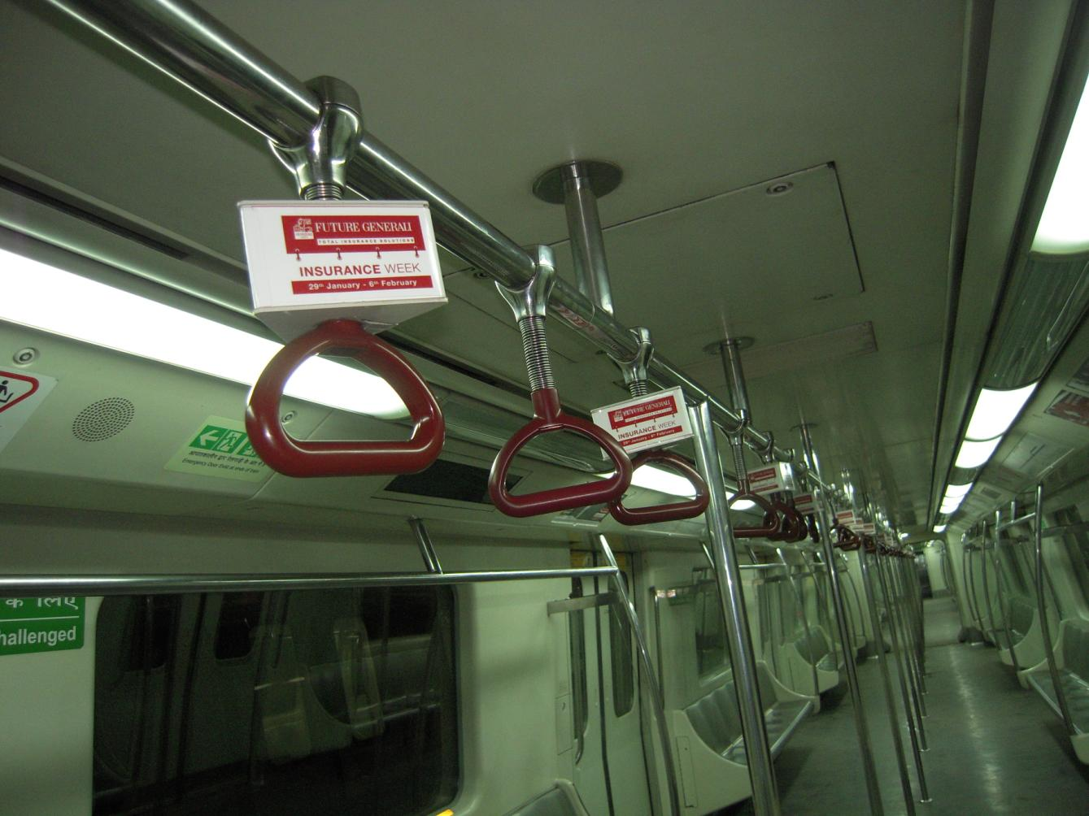
Back to Index

Slide 16
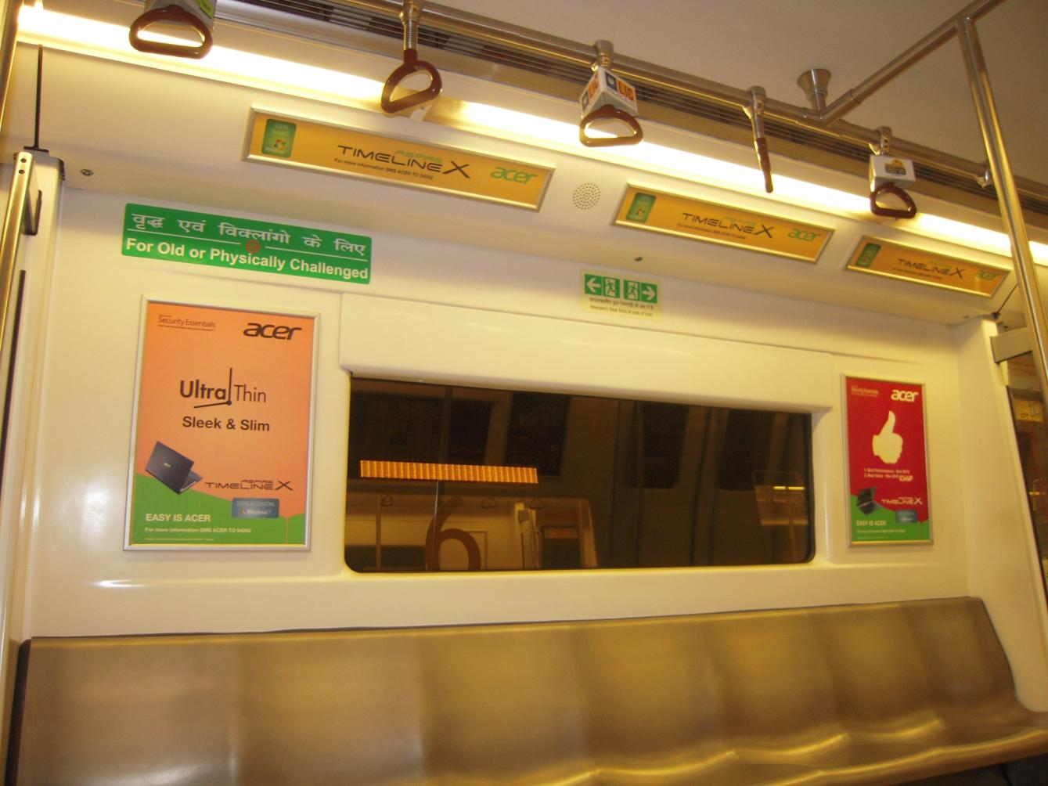
Back to Index

Slide 17
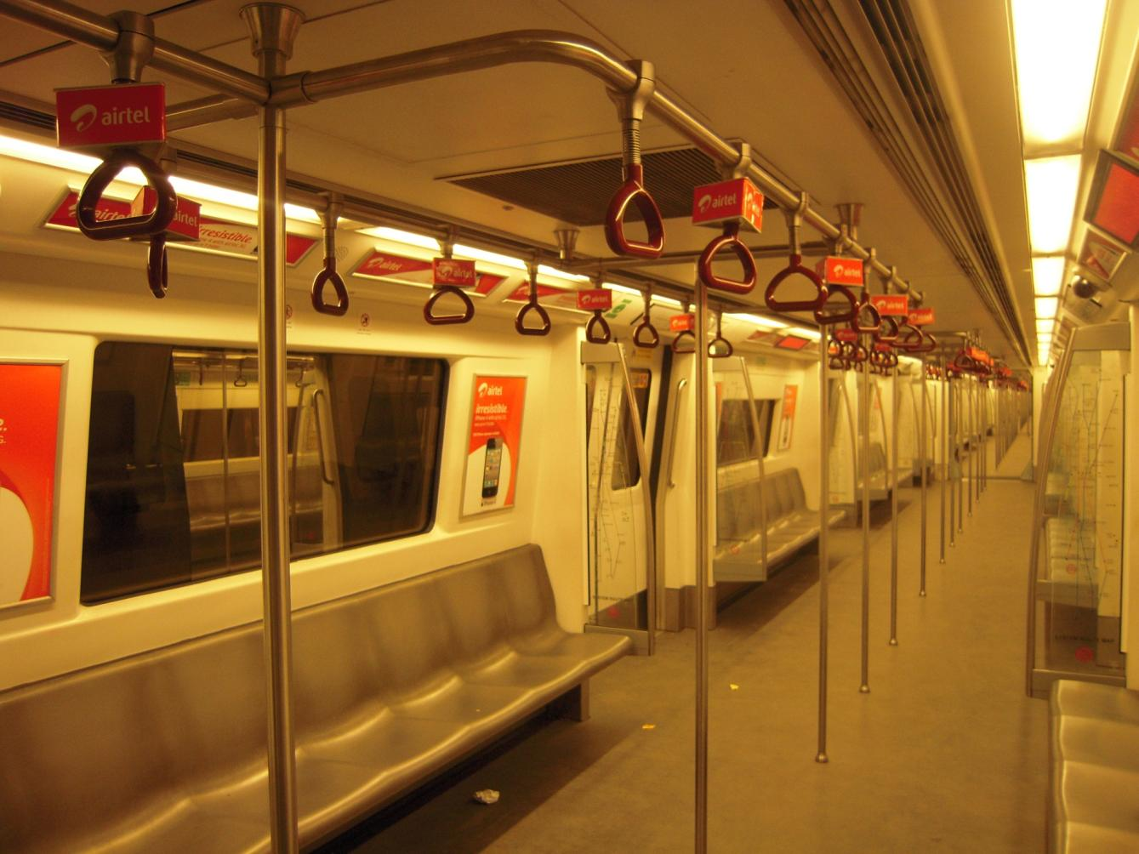

Slide 18
CONTACT DETAILS:
Bhagwati Advertisers
238, Ist Floor, CM-1, Office Complex,
Jhandewalan (Near Videocon Tower)
New Delhi-110055
EMAIL: anupam@baindia.com
CONTACT : 011-23682060/ 41540442
MOBILE : +91-9810170626

